Slide 1
Work integrated term project (WIP)
DE-TOXIFAI
Helping reduce negativity on the internet

Slide 2
BUIlding a safe online space
Fostering Respect and Civility: Constructing an Online Haven of Positivity

Slide 3
Table of contents
01
Problem Statement
02
Roadmap
03
Exploratory data analysis (EDA)
04
MOdel building and training
05
Result analysis
06
Gradio app development and deployment
07
Visualising results
08
Business use case

Slide 4
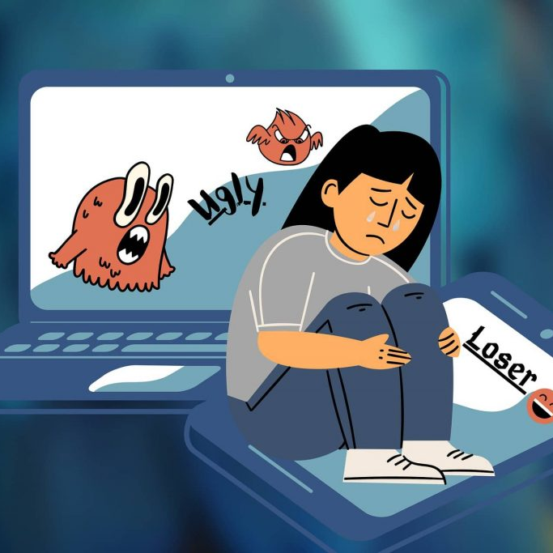
Introduction
Our aim is to build an advanced deep learning model that classifies toxic online comments, enabling platforms to detect and manage harmful content effectively.
Using Gradio, we'll create a user-friendly web app for real-time comment classification, promoting a safer online environment.

Slide 5


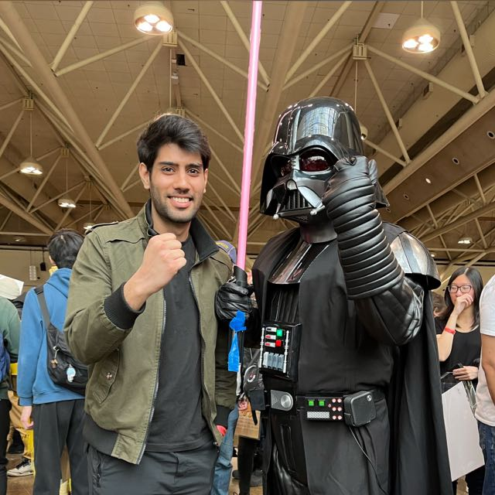
OUR TEAM
garv
sarthak
sukh
101362588
101394349
101421779

Slide 6
01
Problem statement
The pervasive issue of hate and negativity on the internet has profound consequences, including mental distress and, in extreme cases, loss of life. Addressing this concern, our objective is to devise an application that seamlessly integrates with established social media platforms, thereby contributing to a safer online environment.

Slide 7
02
Roadmap
Model Selection,
Data preprocessing
GloVe Model Implementation , Training, Validation and Evaluation
Weeks 1-2
Weeks 5-6
Weeks 8-11
Agile brainstorming, learning models, validating concepts.
Weeks 3-4
LSTM Model Implementation , Training, Validation and Evaluation
Weeks 7-8
BERT Model Implementation , Training, Validation and Evaluation
Gradio App Deployment

Slide 8
03
Exploratory data analysis (EDA)
Where data's toxicity gets mischievously analyzed!

Slide 9
Steps involved
Word CLoud
Label Distribution
Comparison

Slide 10
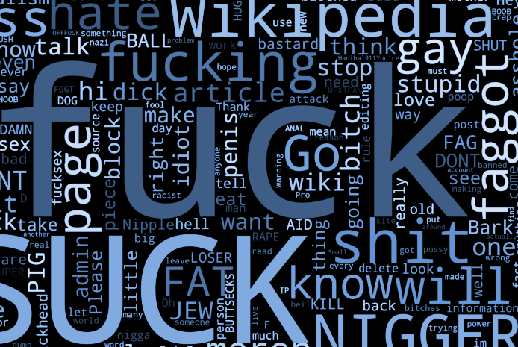
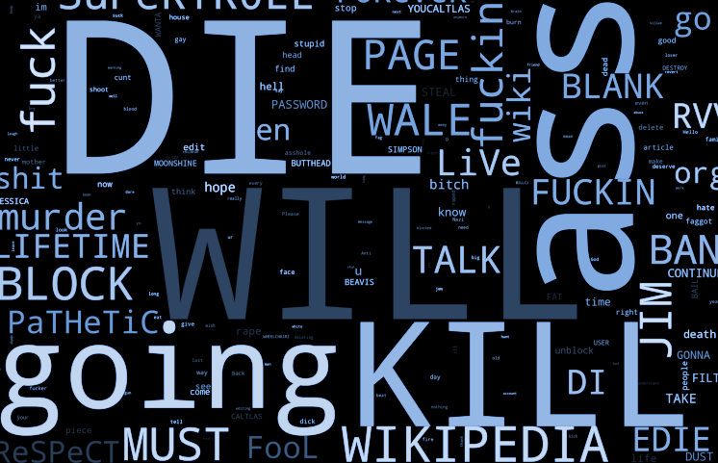
Word CLoud
A picture is worth a thousand words
Reveals frequently occurring words/phrases in text
Identifies keywords tied to toxic comments (e.g., "suck," "fuck," "die," "will kill," "going to kill")

Slide 11
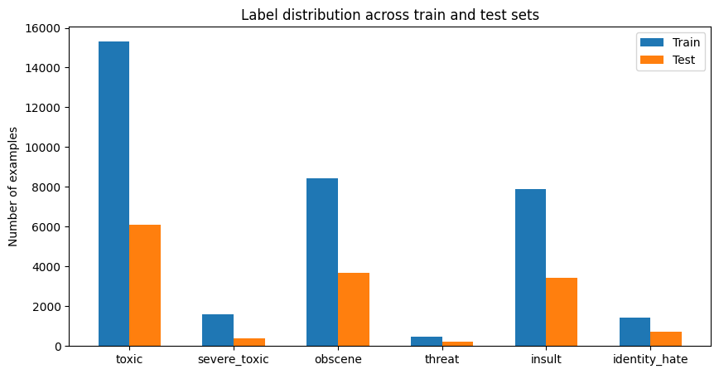
Label Distribution
Determines class imbalance and complexity
Guides data preprocessing, model choice, evaluation
Imbalanced toxic comments distribution poses challenges

Slide 12
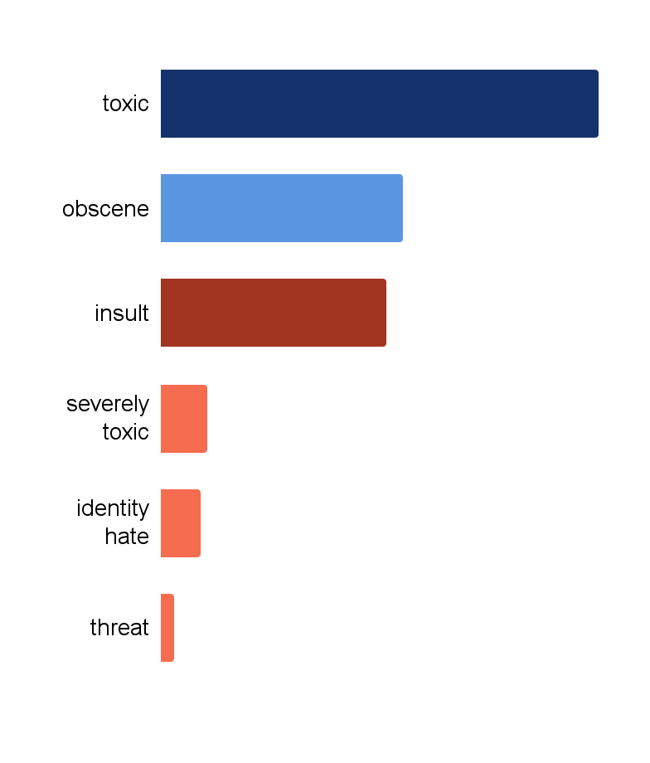
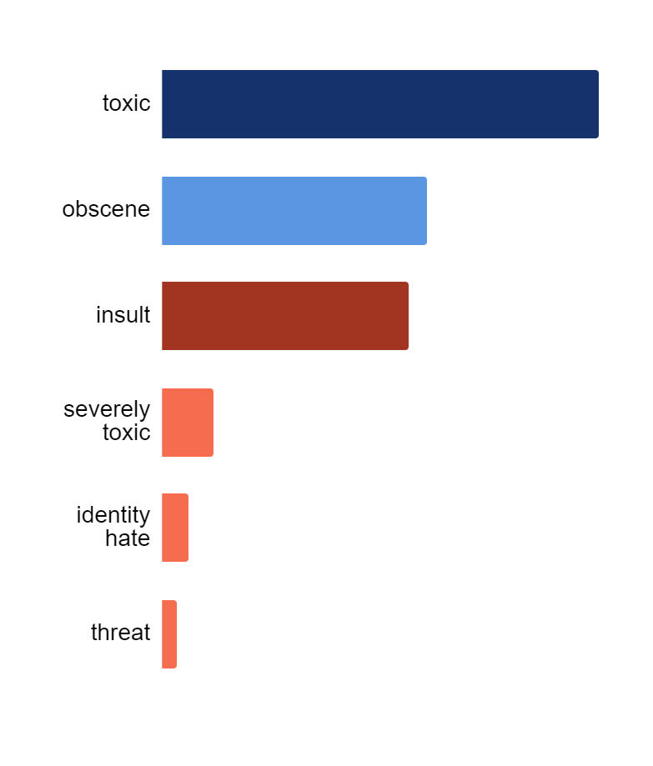
Label Distribution Comparison
Train set
Test set
9.58%
9.52%
5.29%
5.77%
4.94%
5.36%
1%
1.11%
0.88%
0.57%
0.3%
0.33%

Slide 13
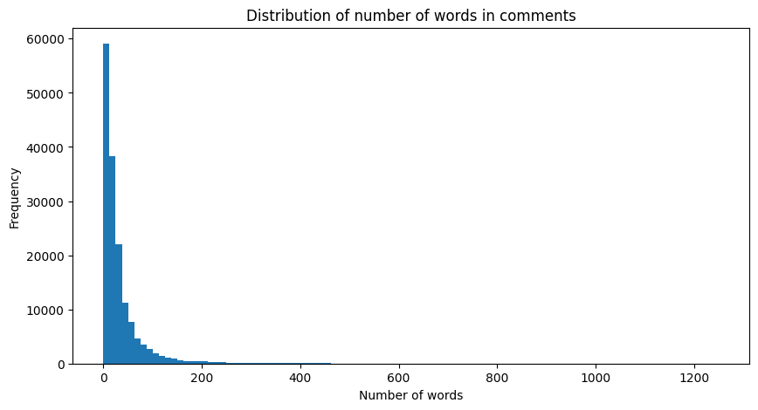
Word Distribution
Since the max length of the words is 200, we use that value for padding to make equally length sentences for deep learning model

Slide 14
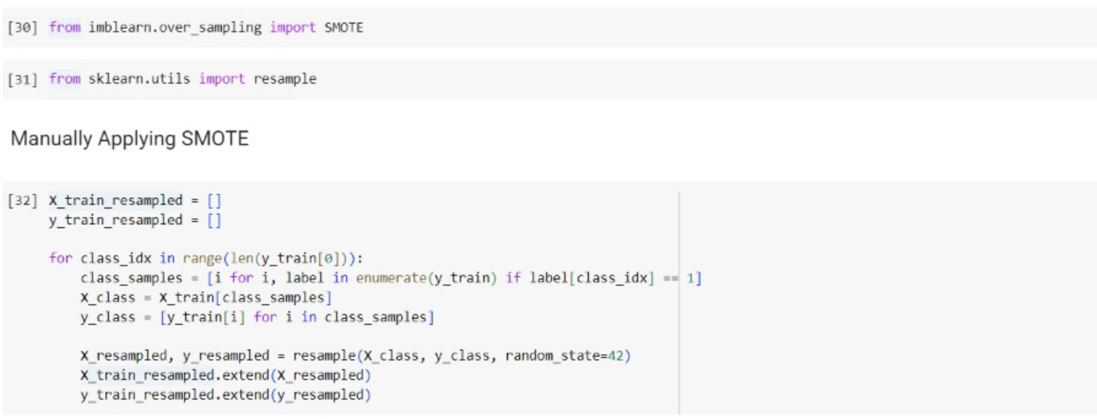
HAndling imbalance
Imbalanced datasets pose a common challenge where the distribution of classes is heavily skewed, leading to biased model performance.
In our dataset the toxic class was heavily skewed, hence we used SMOTE to handle this anomaly.

Slide 15
04
Model Building & Training
Developing the Deep learning model

Slide 16
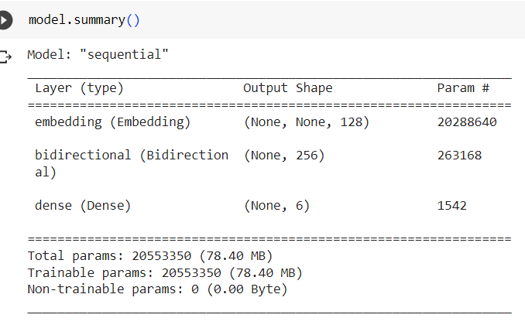
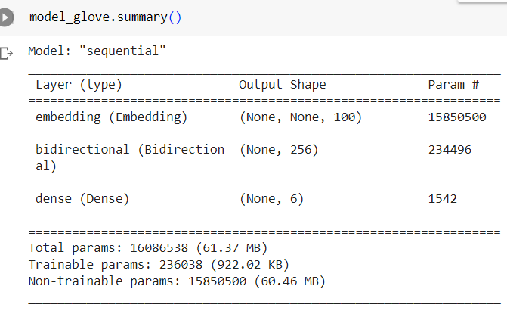
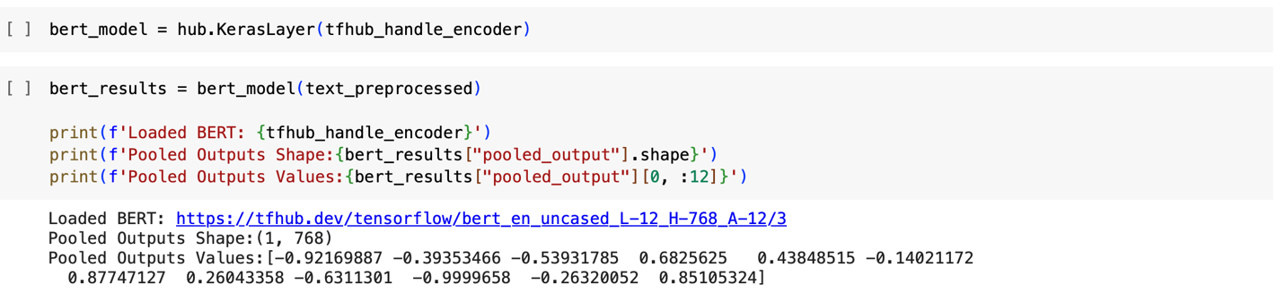
Models
LSTM
GLOVE
BERT
Built a sequential LSTM model with a Bidirectional layer having input dimensions of 128
Built a GloVe model with a bidirectional layer
Developed a BERT Model

Slide 17
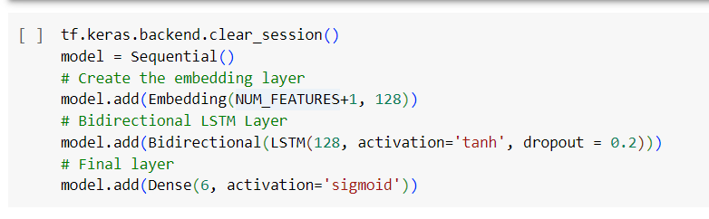
lSTM
Model Architecture

Slide 18
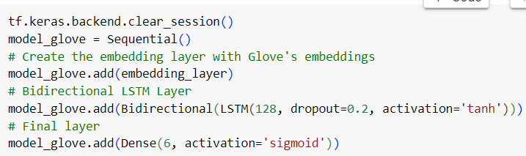
GloVe
Model Architecture

Slide 19
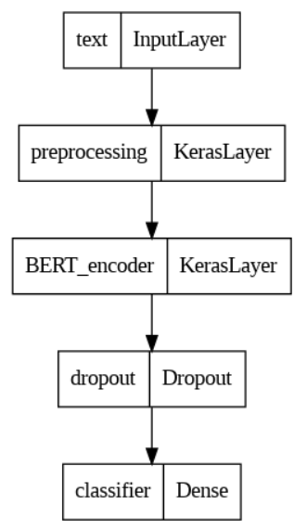
Bert
Model Architecture

Slide 20
05
Results Analysis
How toxic ?

Slide 21
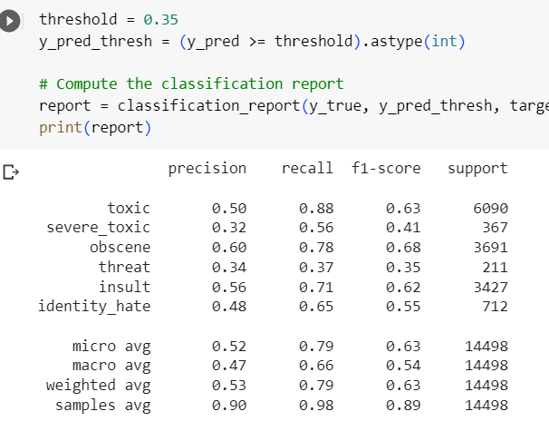
lSTM
Results Analysis

Slide 22
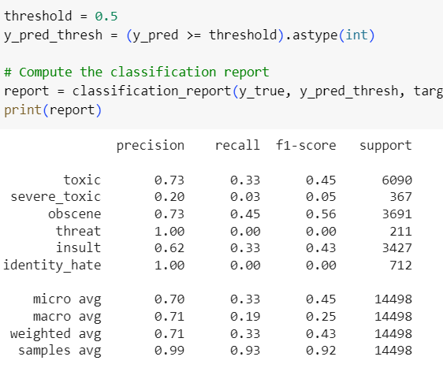
GloVe
Results Analysis

Slide 23
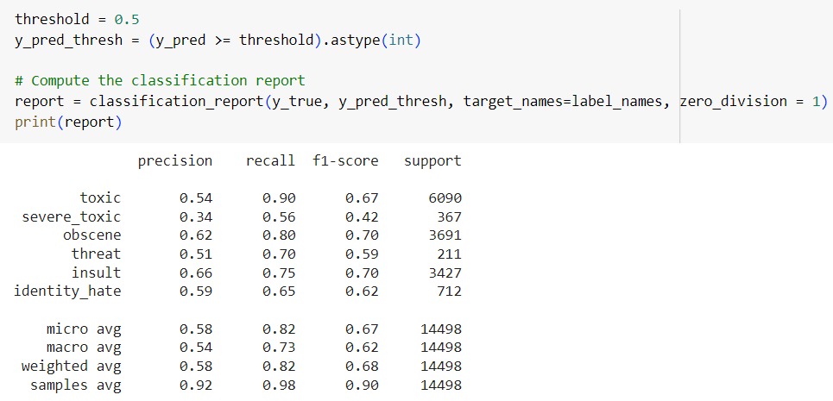
Bert
Results Analysis

Slide 24
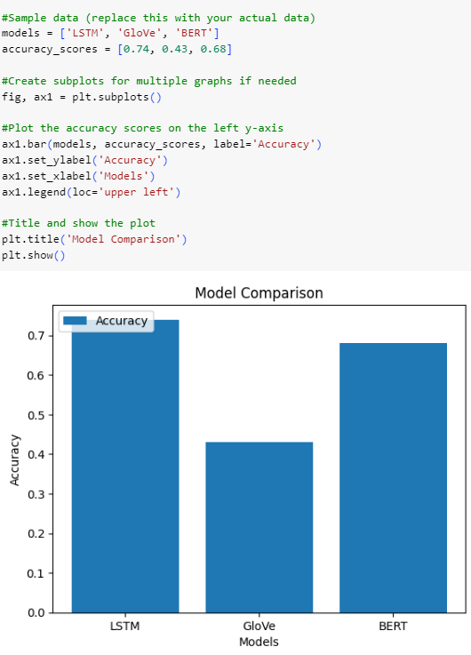
Comparison
Finding the Best Model !

Slide 25
06
Gradio App Development and Deployment
To deploy the Gradio app using LSTM, GloVe, and BERT models, we used several options. Here are two common deployment strategies that we used for this project:

Slide 26
Gradio App Development
Steps the we followed for deploying the app on Local and Global Host
Created a localhost for gradio app
Creating Space on HuggingFace
Using HuggingFace
Deploying model on Space
Creating Global Host

Slide 27
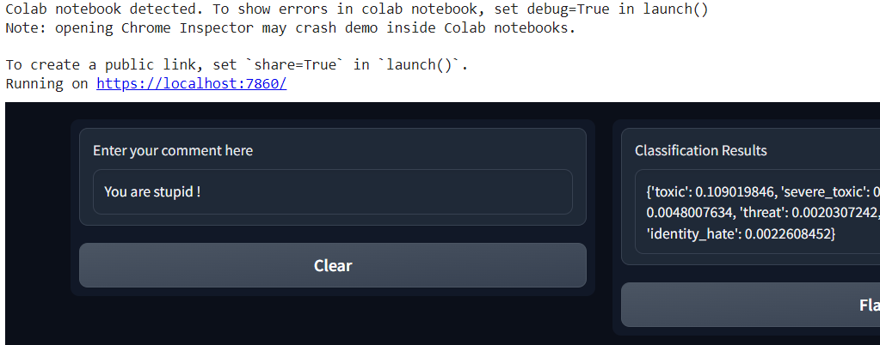
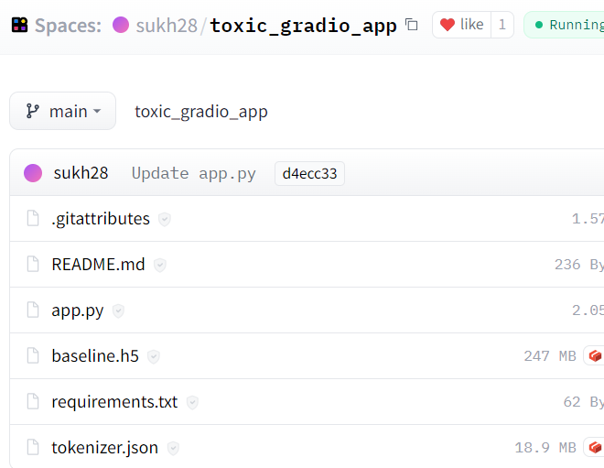
Now, How can we Deploy this app?
Local Deployment
Global Deployment

Slide 28
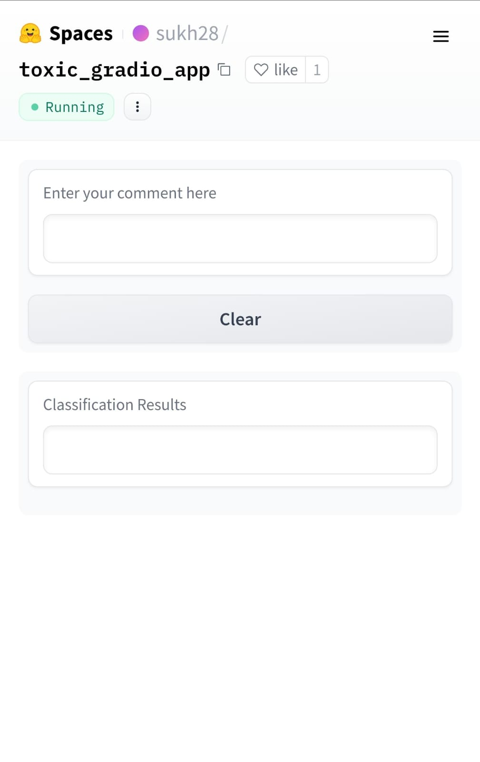
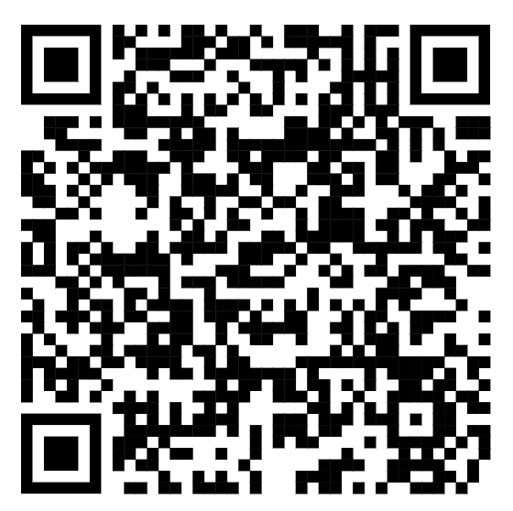
GRADIO WEB-ApP
We created the Gradio app that uses LSTM, GloVe, and BERT models for text classification that used our saved pre-trained models and used them for the app.
Scan to check it out

Slide 29
Target Audience
Social Media Platforms: Facebook, Twitter, Instagram, etc., aiming to maintain a safe online environment for their users.
Content Sharing Websites: Platforms like Reddit, YouTube, and content-driven websites that rely on user-generated content.
Online Forums and Communities: Niche forums and community websites that want to foster respectful discussions among their members.

Slide 30
Business Use Cases
This app can have the following business use cases
Subscription
based model
Developing an API
Licensing the technology

Slide 31
Business Use Cases
This app can have the following business use cases
Subscription
based model
Developing an API
Licensing the technology

Slide 32
Business Use Cases
This app can have the following business use cases
Subscription
based model
Developing an API
Licensing the technology

Slide 33
THANKS!
Any toxic questions?

